Slide 1

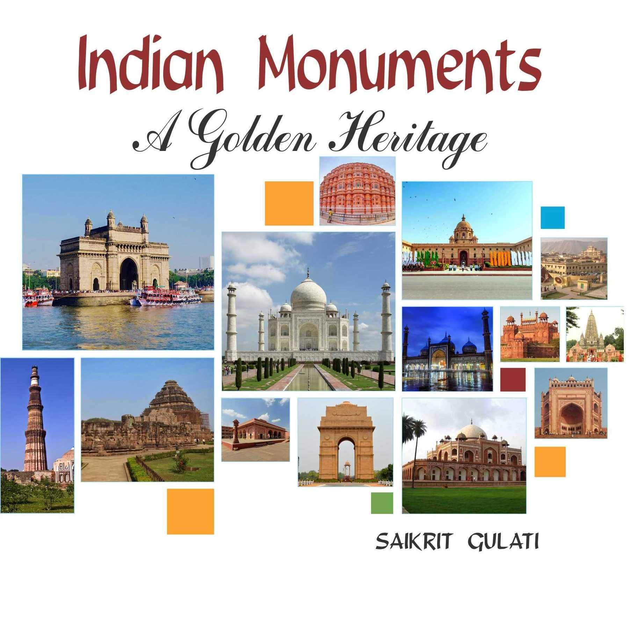
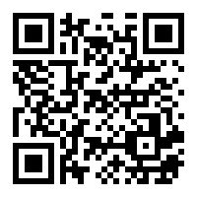
Mini Project Presentation On: “MONUMENTS OF INDIA”
(A Travel Website)
Presented To:
Mr.Rohit Rastogi
Presented By:
Rohit Kumar
1900320100131
Scan to View Site

Slide 2

INDEX
S No. | Title | Slide No.
1 | Problem Introduction | 4-7
2 | Website Overview. | 8-10
3 | Site Map | 11
4 | Related Previous Work | 12
5 | Deliverables | 13
6 | Software & Hardware Requirements | 14-15
7 | User Guide | 16
8 | User Case Diagram | 17
9 | Stakeholders | 18
10 | Gantt Chart | 19
11 | References | 20

Slide 3
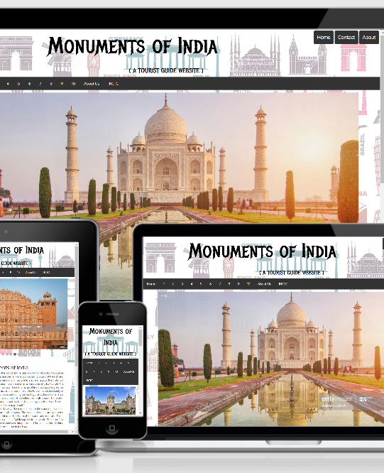
1.Problem Description
The problem is Identified by these factors :
In these busy times people are busy in their work like using (like smartphone , professional work).They have no free time to go over the beauty of India.
Peoples go through Malls , Cinema halls to spend their Valuable time and to feel happy.
As the future arises people will forget about monuments.
This Website will Guide/Motivate these people to go through the real beauty of India.

Slide 4
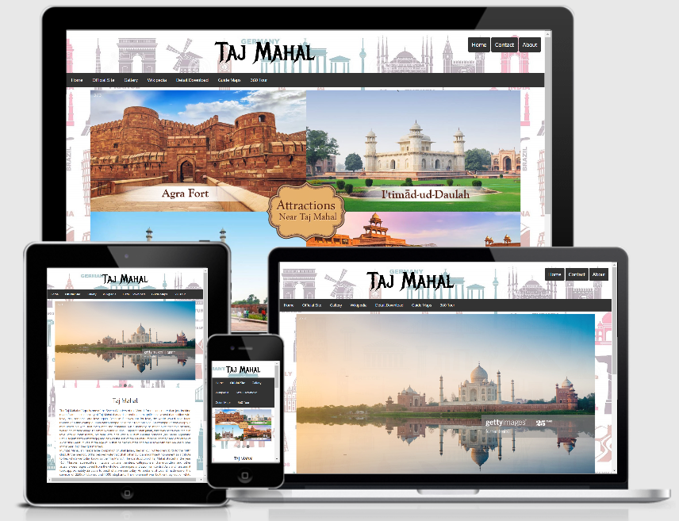
(i) Motivation
The thing which Motivate me to build this Website are:
The decrement of People excitement towards traveling.
Decreasing Number of Tourists.
Impact of COVID-19 on Tourism
(ii) Website Objective
The main objective to build this Website is to regenerate the attraction of People towards these and Increase the Number of Visitors.

Slide 5
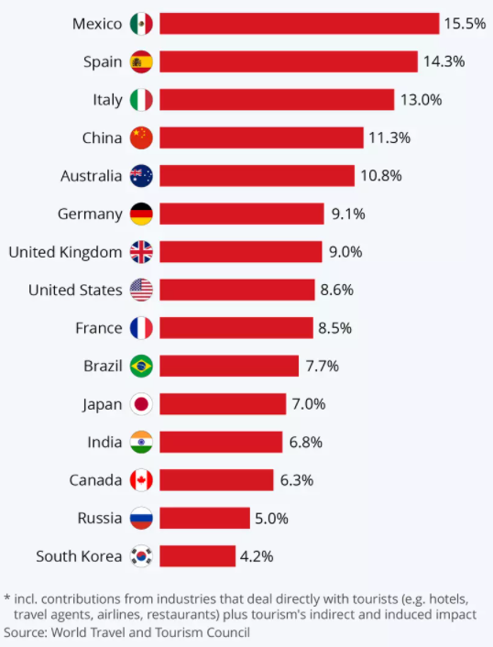
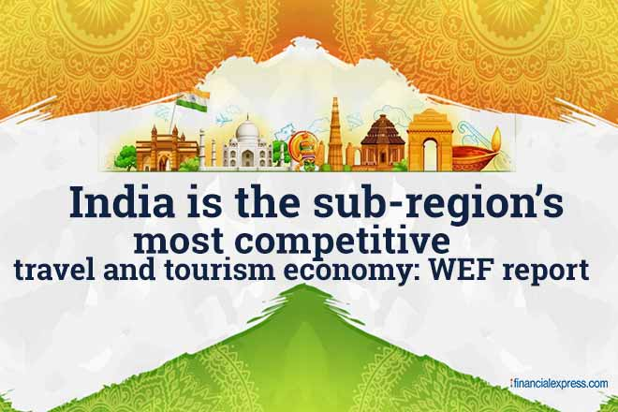
Tourism Contribution
India is among the top 15 Country in the world whose economy is influenced by Tourism.
About 6.8% of Economy is influenced by Tourism
(Source: World Travel & Tourism Council)

Slide 6
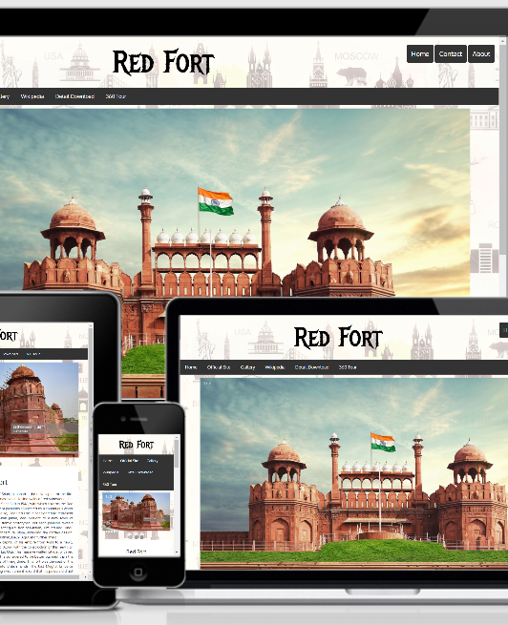
(iii) Scope of this Website
These Website is further Extended to high level if I have time and all the Sources in these ways :
Main Scope :
Providing Traveling Distance to the Visitors from their homes.
Providing E-Prospectus about these Monuments
Other Possible Scopes :
E – Ticketing System to book visiting Tickets.
Providing Taxi at these Places.
Opening Travel Agency.
To book Railway/Airplane Tickets through IRCTC.

Slide 7
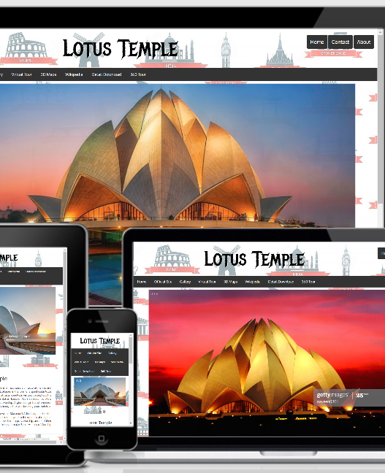
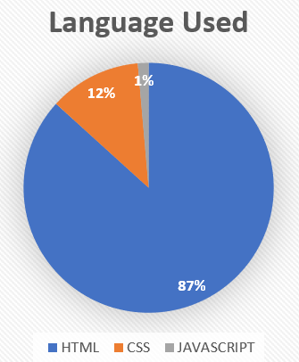
2.Website Overview
This Website Consists of 12 Webpages:
1.Monuments of India 2.Taj Mahal 3.Red Fort 4.Lotus Temple 5.Qutub Minar 6.Victoria Memorial 7.Gateway of India 8.Charminar 9.Hawa Mahal 10.Mysore Palace 11.CST 12.About Us

Slide 8
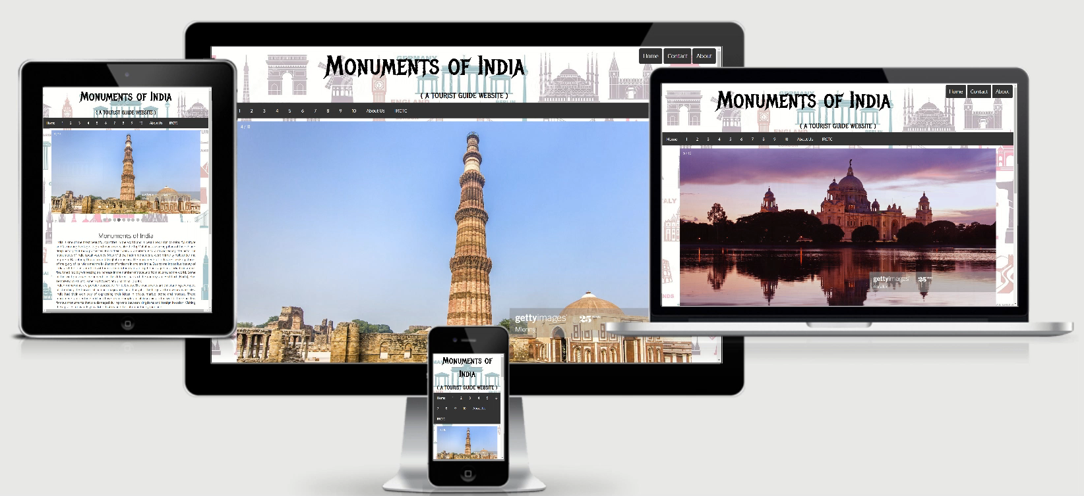
Responsive View

Slide 9
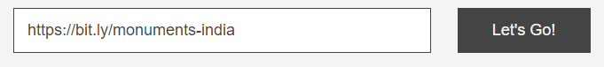
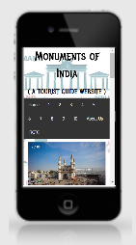
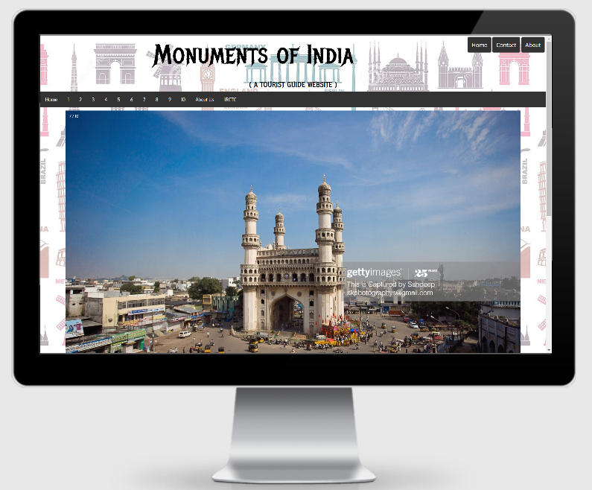
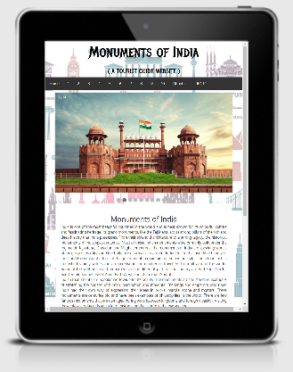
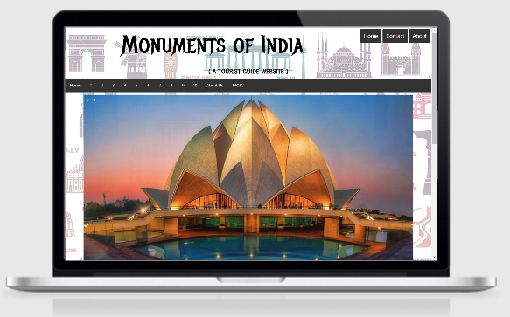

rebrand.ly/monumentsofindia
GitHub Pages
PC
Mobile
Laptop
Tablet
GitHub Pages Server

Slide 10
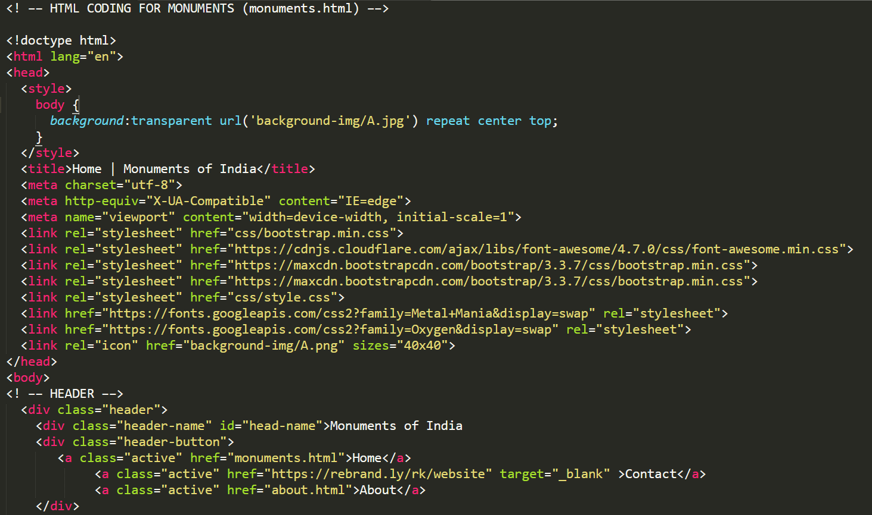
Sample Code Snippets

Slide 11
HOME (monuments.html)
1.Taj Mahal 2.Red Fort 3.Lotus Temple 4.Qutub Minar 5.Victoria Memorial 6.Gateway of India 7.Charminar 8.Hawa Mahal 9.Mysore Palace 10.CST
Information
Gallery
Maps
Video
3D View
User Count
3.Site Map
ABOUT Us (about.html)

Slide 12
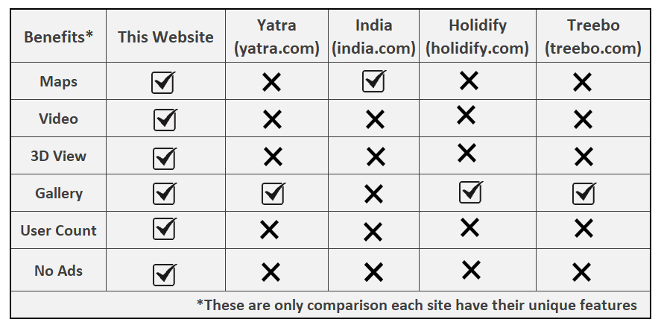
4.Related Previous Work/Literature Survey

Slide 13
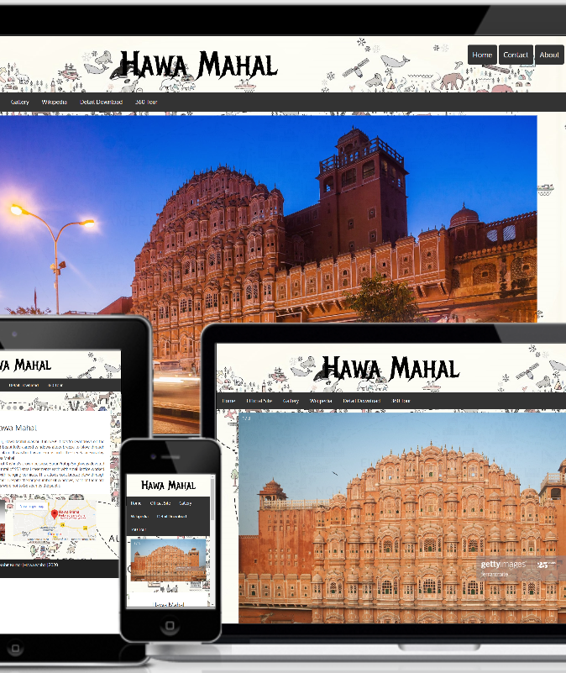

5.Deliverables
The Main Deliverables of this Website are:
This Website provide :
Basic Information
Location of the Monuments
3D View
Video
Visitor Count
This Website provides link to Access Yatra ,IRCTC ,OYO & many more websites.
This Website will also provide all Essential links that you will have to visit once to choose the best place to travel.

Slide 14






6(i).Hardware Requirements
This Basic Hardware Require to Build or Execute this website:
Processor: Minimum 1 GHz; Recommended 2GHz or more
Ethernet connection (LAN) OR a wireless adapter (Wi-Fi)
Hard Drive: Minimum 32 GB; Recommended 64 GB or more
Memory (RAM): Minimum 1 GB; Recommended 4 GB or above
Sound card with speakers

Slide 15

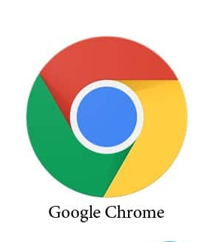


6(ii).Software Requirements
This Basic Software Require to Build or Execute this website:
Operating System: Windows: XP,Vista,7 or newer
MAC: OS X v10.7 or higher Linux
Android KitKat or newer and many other
Web Browser (Latest version of Google Chrome, Microsoft Edge, Mozilla Firefox etc).
A Code Editor
Git / GitHub Desktop and GitHub

Slide 16
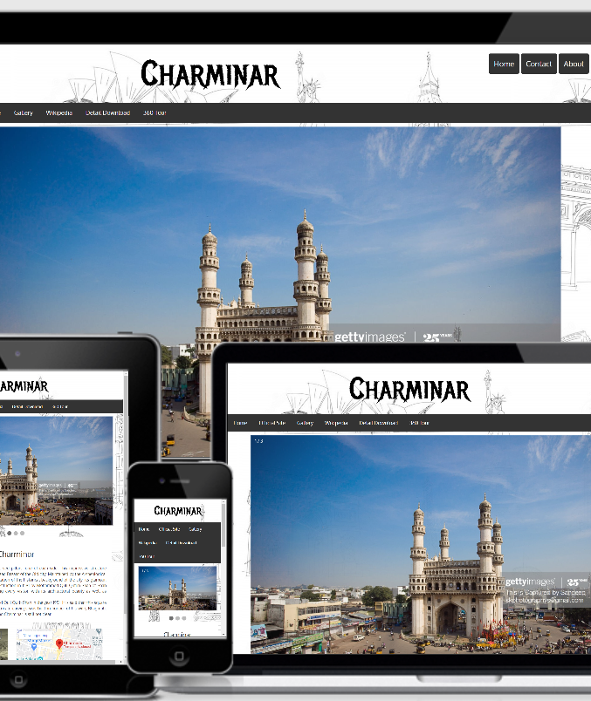
7.User Guide
START
1
Visit rebrand.ly/monumentsofindia
2
Visit particular webpage of Each Monuments
3
Go through the Video,3D View ,Maps and Essential Information.
STOP

Slide 17
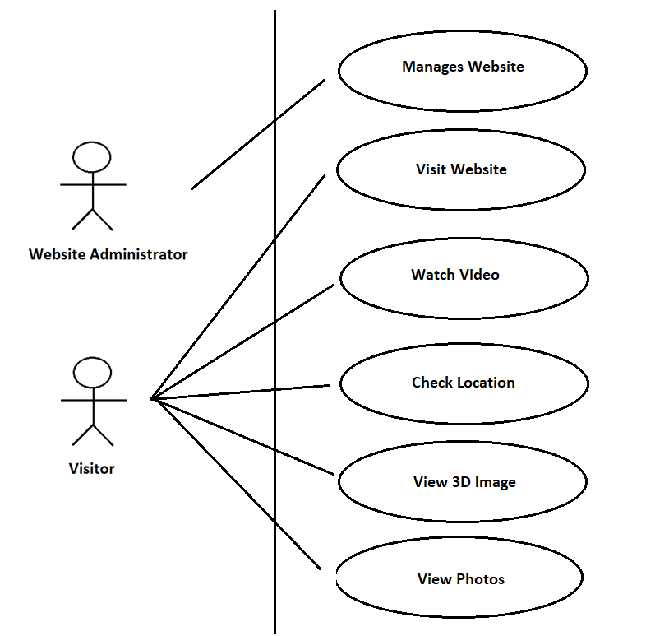
8.User Case Diagram
SECTION 1 TITLE
SECTION 2 TITLE

Slide 18
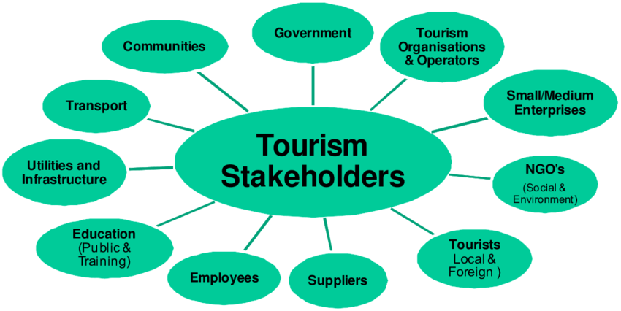
9.Stakeholders

Slide 19
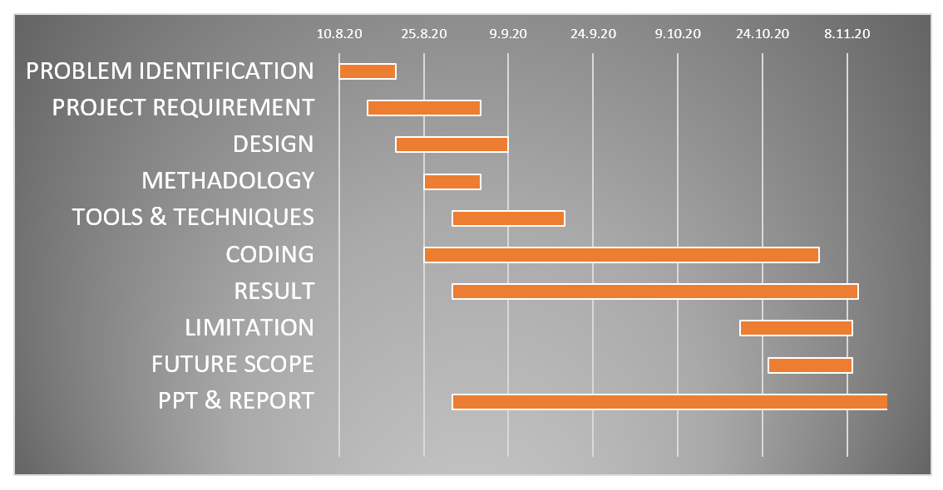
10.Gantt Charts
From : 10/08/2020 To 10/11/2020

Slide 20


11.References
W3Schools : https://www.w3schools.com/
HTML,CSS & JavaScript (Coursera): https://www.coursera.org/
Getty Images : https://www.gettyimages.in/
Google Maps : https://www.google.co.in/maps
Google YouTube: https://www.youtube.com/
Yatra: https://www.yatra.com/
Lestari,D., Hardianto,D., Hietayanto,A.,(2014), “Analysis of User Experience Quality on Responsive Web Design from its Informative Perspective”, International Journal of Software Engineering and its Applications,(5),53-62.
Kumar, S Praveen. (2014). “Monuments for the Development of Tourism” , Impact Factor, 0.3481. 87-94.
Navratil,J., Picha,K., Hrebcova,J. (2010), “The Importance of Historical Monuments for Domestic Tourists: The case of South-Western Bohemia (Czech Republic).” Moravian Geographical Reports, 18. 45-61.

Slide 21
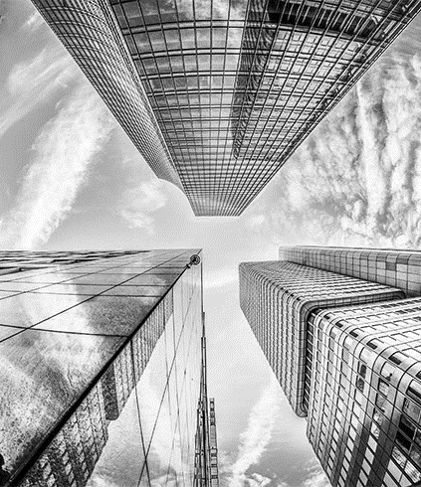

THANK YOU Any Queries ?? (Feel free to Ask)
https://rebrand.ly/monumentsofindia OR
Click Link Scan

